Slide 1
Wellesley-Weston Lifetime Learning
Learn! Engage! Interact! Enjoy!
© 2022 Wellesley-Weston Lifetime Learning. All rights reserved.

Slide 2
Wellesley-Weston Lifetime Learning
About 250 seniors from the Western suburbs meet Monday mornings for ten weeks each spring and fall
WWLL is the second oldest lifetime learning program in U.S.
Diverse and stimulating courses in a learning community - Something for everyone!
An all-volunteer organization drawing on Boston-area professionals as teachers
All that’s required is a desire for intellectual stimulation, vigorous discussion and good camaraderie

Slide 3
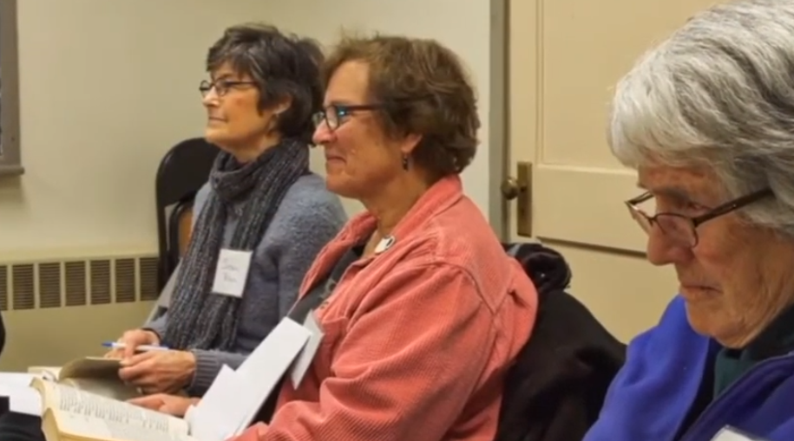
About Lifetime Learning
The fastest growing segment of the educational market, according to The Washington Post
By 2034, there’ll be more seniors than persons under 18

Slide 4
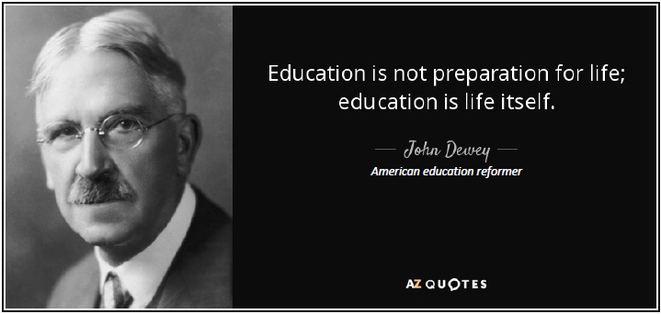

Slide 5
Thinking Outside the Box . . .
People think of education as something that they can finish.
If you enjoy learning, there's no reason why you should stop at a given age.

Slide 6
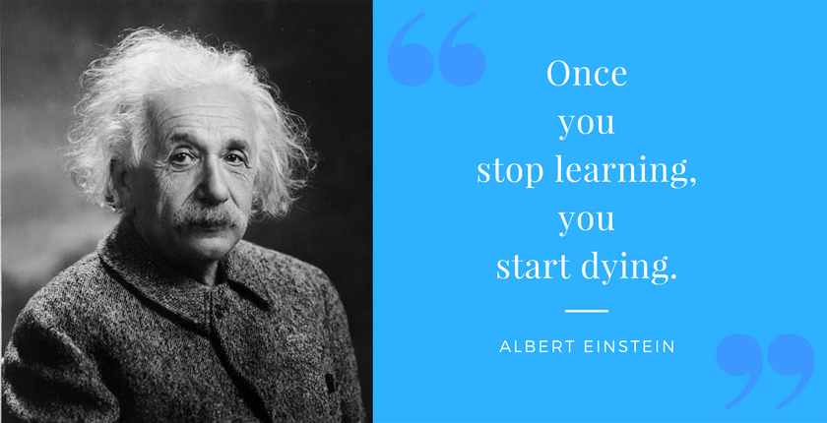

Slide 7
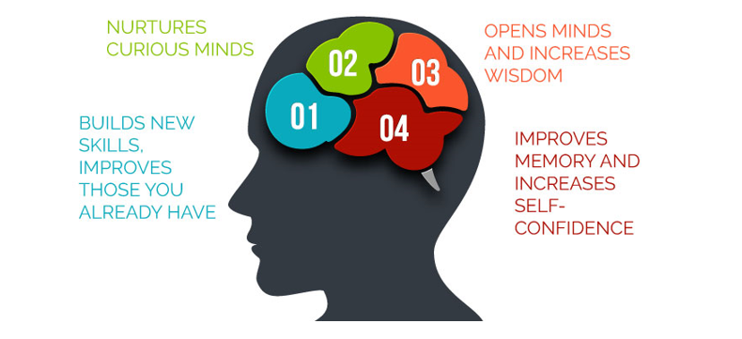
Lifetime Learning Benefits: Overview

Slide 8
Lifetime Learning Benefits: Expanded
Medical
Learning something new helps boosts your memory
Lowers your stress level
Slows your heart rate
Eases muscle tension
MGH / Harvard Medical School study: Seniors who reported higher levels of intellectual stimulation throughout their lifetimes had a marked delay in onset of memory problems or other Alzheimer’s type symptoms.
Harvard/Princeton research on the connection between lifelong learning and health
Reading for just six minutes lowered participants’ stress levels, slowed heart rates and eased muscle tension
Lowering stress enhances seniors’ cardiovascular health, decreases blood pressure, reduces the risk of a stroke or heart attack, boosts immunity, and lowers level of depression.

Slide 9
Lifetime Learning Benefits: Expanded (Cont’d)
Social
Make new friends
Join old friends
Develop camaraderie with like-minded men and women thirsting for knowledge
Educational
Isn’t there a subject you always wanted to know more about?
Learn from talented instructors
A supportive, inclusive learning environment

Slide 10
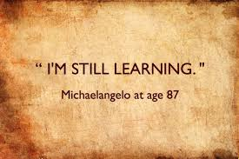

Slide 11
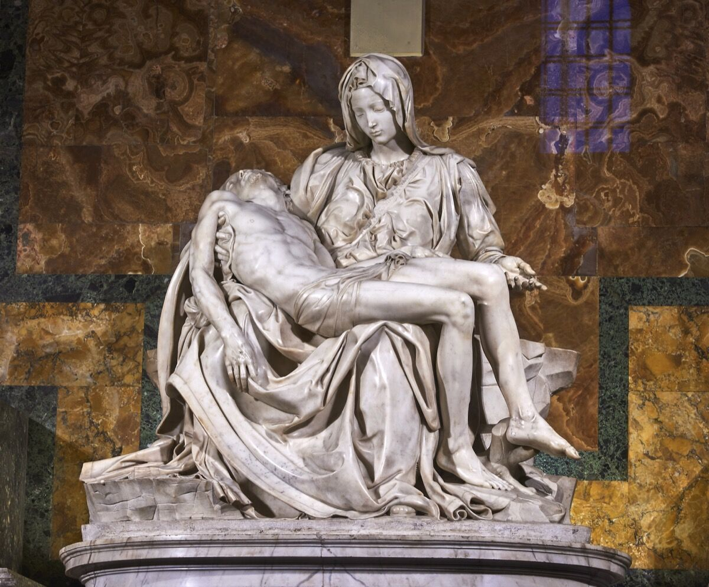
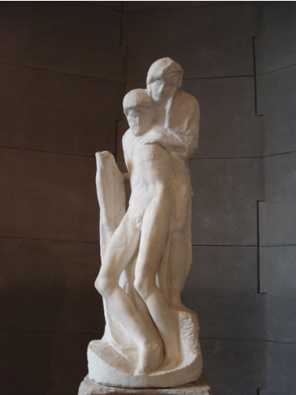
Self-renewal
Michelangelo sought to stay fresh and reinvent himself, returning twice to the Pieta theme and bringing a more human interpretation
Reflecting on mortality, he worked on his Rondanini Pieta until age 89. While unfinished, it is considered another masterpiece
1st - Youthful bravado
3rd – Humility of old age

Slide 12
Registration Details
10-week semesters each Spring and Fall
All classes on Monday mornings
2 class periods: 10-11am and 11:30-12:30pm
~8-10 classes each semester on a range of subjects
No prior qualifications required.
For course descriptions and registration, go to: www.wwllcourses.org

Slide 13
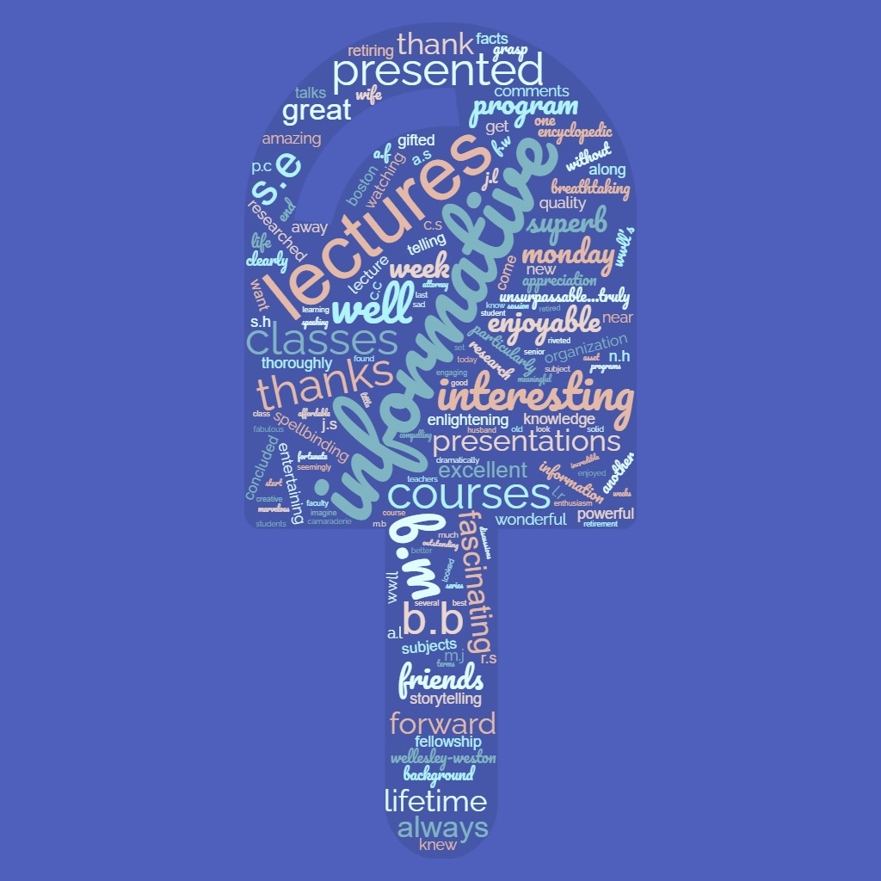
Representative Student Comments
“After retiring, these Monday classes always get my week off to a good start: fabulous lectures, discussions and camaraderie.”
“Presentations are superb, both in terms of enthusiasm, knowledge, organization of the facts, and quality of speaking.”
“Gifted teachers. I, along with all the other students are so very fortunate. With much thanks and appreciation.”
In a Word Cloud, the size of each word indicates its frequency and importance across all feedback and comments.

Slide 14
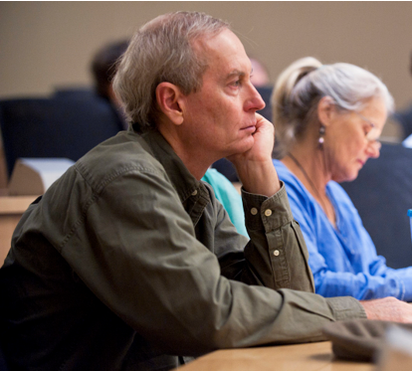
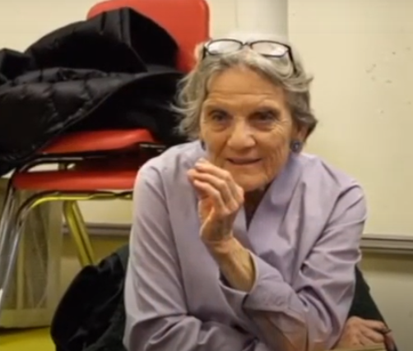
What does a lifetime learner look like?

Slide 15
Learn! Engage! Interact! Enjoy!
For semester dates, course descriptions, and registration go to:
www.wwllcourses.org

